Slide 1
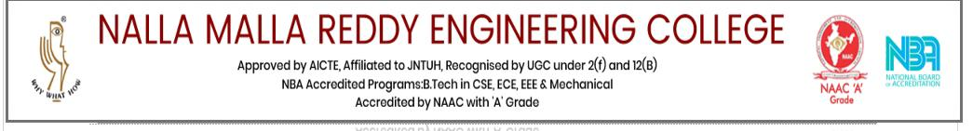
A
Mini Project (Internship)
On
Data Science and Full Stack Web Development
Name : K. Shivani
Roll no: 20B61A6622
Branch: CSE(AIML)-4A

Slide 2
CONTENT
Introduction To linux Operating System
Agile Methodology & GIT Version Software
HTML & CSS
Java script
Python programming
Tool Jet
Rust Programming Language
Data Visualization using JS Session
Android Debugging
Aptitude (Logical, Reasoning & Puzzles)
Coding or Programming Skills
Interview Skills

Slide 3

Linux Operating System:
Open-source, Unix-like operating system.
Kernel at its core, with distributions like Ubuntu, Fedora, and CentOS.
Command-line interface (CLI) for system administration.
Multitasking, multiuser, and stable.

Slide 4
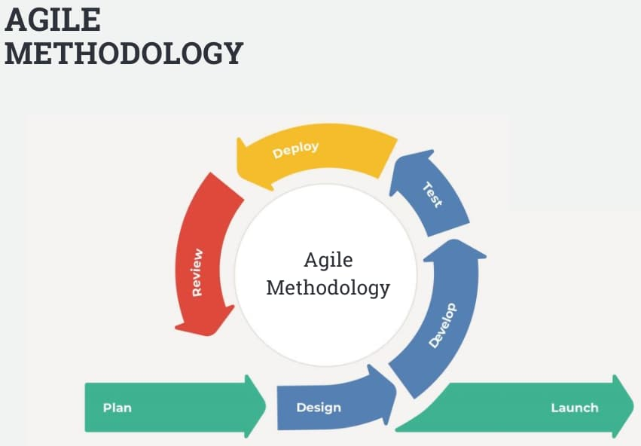
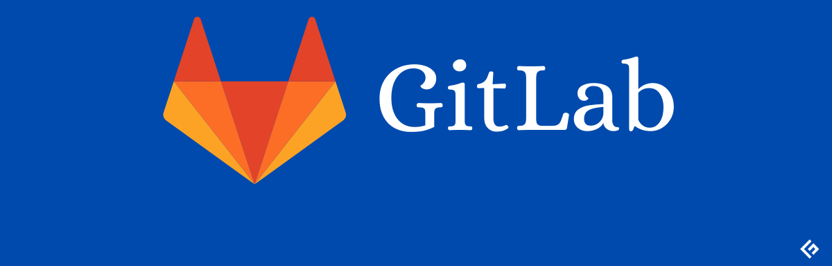
Agile Methodology and GIT Version Software:
Agile: Iterative and incremental software development approach.
Agile methodoloy is a practice that helps continuous iteration of development and breaking down of project into phases .
It promotes the sustainable development of develop user and sponser should work together .
For developing effective software work on improving over all development process .
Git is diatributed version on control system that enables software develop then to have multiple load copies of project codebase independent of each other .
It modify file in workinv directory
Git handle content in snapshots, one for each commit and know how to apply back the change in snapshot

Slide 5
HTML & CSS:
HTML (Hypertext Markup Language): Standard markup language for creating web pages.
CSS (Cascading Style Sheets): Styles web documents, enhancing layout and presentation.
HTML defines structure, CSS controls appearance.
JavaScript:
High-level, interpreted scripting language.
Used for client-side web development.
Enables interactive and dynamic web pages.
Compatible with most browsers

Slide 6
Python Programming:
High-level, versatile programming language.
Emphasizes readability and ease of use.
Extensive standard library.
Widely used in web development, data science, and automation.
Tool Jet:
JetBrains IDEs, including IntelliJ IDEA, PyCharm, and WebStorm.
Supports various programming languages.
Features code navigation, debugging, and version control integration.

Slide 7
Rust Programming Language:
Systems programming language emphasizing safety.
Zero-cost abstractions without garbage collection.
Memory safety through ownership and borrowing concepts.
Data Visualization using JS Session:
JavaScript libraries like D3.js for data visualization.
Interactive and dynamic charts, graphs, and maps.
Emphasizes conveying insights through visual representation.

Slide 8
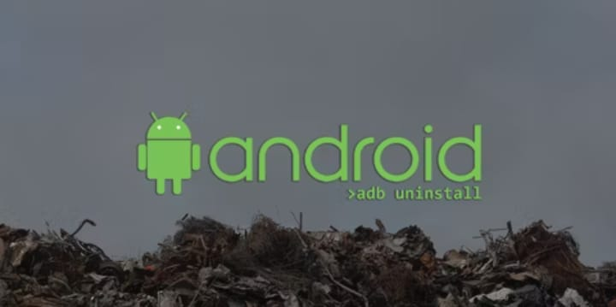
Android Debugging:
Debugging tools like Android Studio's debugger.
Logcat for logging and tracing.
Identifying and fixing runtime issues in Android apps.
Aptitude (Logical, Reasoning, and Puzzles):
Logical reasoning assesses problem-solving ability.
Reasoning evaluates logical thinking and decision-making.
Puzzles test critical thinking and pattern recognition.

Slide 9
Coding or Programming Skills:
Proficiency in languages like Java, Python, C++.
Problem-solving through algorithms and data structures.
Writing efficient and readable code.
Interview Skills:
Effective communication of technical knowledge.
Problem-solving under pressure.
Showcasing experience and achievements confidently.

Slide 10
CONCLUSION
In conclusion, Rust offers robust systems programming with a safety focus. JavaScript data visualization enables dynamic insights representation. Android debugging and aptitude skills contribute to problem-solving proficiency. Versatile coding skills in HTML, CSS, JavaScript, and Python highlight web development capabilities. Familiarity with Linux, Agile, and GIT reflects a holistic software development understanding. Interview skills and tool proficiency, like JetBrains' IntelliJ IDEA, ensure effective communication and technical competence.

Slide 11
THANK
YOU

